Slide 1

HOME AUTOMATION USING ARDUINO
BY
RENANGI VENKATA NIVAS SANAMPUDI SIVA SAI
(192U1A04D2) (192U1A04D4)
SHAIK ABDUL HAMEED SHAIK ANWAR BABU
(192U1A04D6) (192U1A04D7)

Slide 2
CONTENT
INTRODUCTION 6. CIRCUIT DIAGRAM
COMPONENTS REQUIRED 7.BLOCK DIAGRAM
ARDUINO UNO R3 8.WORKING
BLUETOOTH MODULE 9.PROS
RELAY 10.APPLICATIONS
11.CONCLUSION

Slide 3
INTRODUCTION
There is an increasing demand for smart homes where appliances react automatically to changing environmental conditions and can be easily controlled through one common device.
This project presents a possible solution where the user controls the device by using their existing mobile phone.

Slide 4
What is Home Automation?
Home Automation involves introducing a degree of computerized or automatic control to certain electrical electronics system in a building.
These lighting, temperature control etc … this paper demonstrate a simple home automation system which contains a remote mobile host controller and several client module (home appliances).
The client modules communicate with host controllers through a wireless device such as Bluetooth enabled mobile phone.

Slide 5
COMPONENTS REQUIRED
ARDUINO UNO
2 CHANNEL RELAY (5V)
BLUETOOTH MODULE HCO5
POWER SUPPLY
LOAD (BULB 220V)
CONNECTING WIRES
VERO BOARD
SMARTPHONE (BLUETOOTH ENABLED)

Slide 6
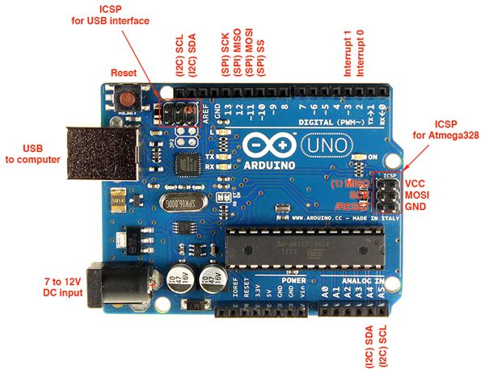
ARDUINO UNO R3
A

Slide 7
ARDUINO UNO
ARDUINO IS AN OPEN SOURCE HARDWARE AND SOFTWARE COMPANY, PROJECT AND USER COMMUNITY THAT DESIGNS AND MANUFACTURES SINGLE MICROCONTROLLERS AND MICROCONTROLLER KITS FOR BUILDING DIGITAL DEVICES.
Arduino UNO is based on an ATmega328P microcontroller . It is easy to use compared to other boards, such as the Arduino Mega board, etc. The board consists of digital and analog Input/Output pins (I/O), shields, and other circuits.
The Arduino UNO includes 6 analog pin inputs, 14 digital pins, a USBconnector, a power jack, and an ICSP (In-Circuit Serial Programming) header. It is programmed based on IDE, which stands for Integrated Development Environment. It can run on both online and offline platforms.

Slide 8
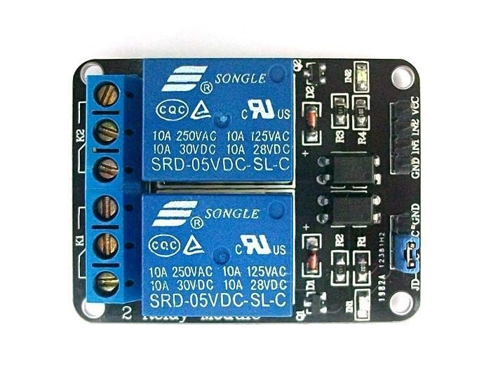
CHANNEL RELAY

Slide 9
CHANNEL RELAY
A relay is an electrically operated switch.
Relays are used where it is necessary to control a circuit by a low power signal.
Relays protect electrical circuits from overload or faults.

Slide 10
2 CHANNEL RELAY FEATURES
Number of Relays : 2
Control Signal : TTL level
Rated load : 7A/240VAC 10A/125VAC 10A/28VDC
Contact Action Time : 10ms/5

Slide 11
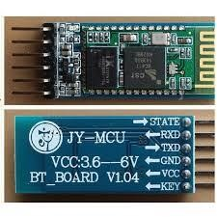
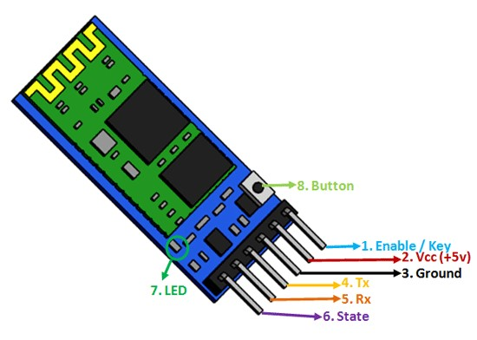
BLUETOOTH MODULE

Slide 12
HC05 BLUETOOTH MODULE
HC05 is a Bluetooth Smart module targeted for low power sensors and accessories.
It integrates all features required for a Bluetooth Smart application .
Using Bluetooth has many of its own advantages:
1. it’s secure.
2. easy to use.
3. it works in short distance range.
4. any one can find free Bluetooth apps on android and many more.

Slide 13






BLOCK DIAGRAM
BLUETOOTH MODULE
RELAY
MODULE
ARDUINO UNO
R3
LOAD
9v POWER
SOURCE
MAIN POWER
SOURCE(220V)

Slide 14
WORKING
ANDROID BASED HOME AUTOMATION USING BLUETOOTH PROJECT HELPS THE USER TO CONTROL ANY ELECTRONIC DEVCE USING DEVICE CONTROL APP ON THEIR ANDROID PHONE.
THE ANDROID APP SENDS COMMAND TO THE CONTROLLER – ARDUINO THROUGH WIRELESS COMMUNICATION, NAMELY, BLUETOOTH.
THE ARDUINO IS CONNECTED TO THE MAIN PCB WHICH HAS RELAYS AS SHOWN IN BLOCK DIAGRAM. THESE RELAYS CAN BE CONNECTED TO DIFFERENT ELECTRONIC DEVICES LIKE LIGHTS,FANS ETC.
WHEN THE USER PRESSES THE ‘ON’ BUTTON DISPLAYED ON THE APP, THE BUZZER IS SWITCHED ON.THIS BUZZER CAN BE SWITCHED OFF BY CLICKING THE SAME BUTTON AGAIN.
THIS PROJECT OF HOME AUTOMATION USING BLUETOOTH AND ARDUINO CAN BE USED FOR CONTROLLING ANY AC OR DC DEVICES.

Slide 15
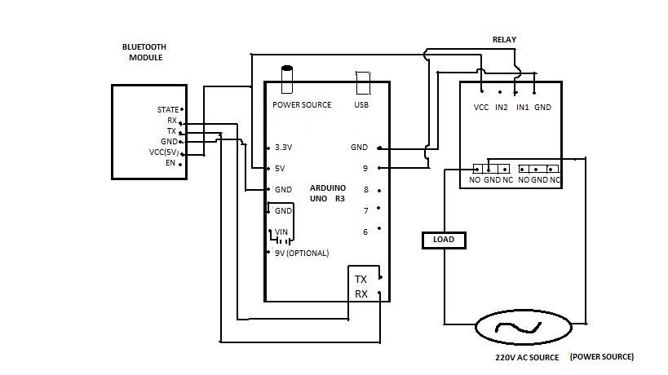
CIRCUIT DIAGRAM
C

Slide 16
APPLICATIONS
Home automation – This project can be used to control various Home Appliances
2. We can control device from a long distance, thus it gives ease of access.
3. Faster operation and efficient.
4. No need to arry separate remote or any other controlling unit.

Slide 17
PROS
The main advantage of “Home Automation through Android Mobile” is that the “Physically Challenged and Disabled People” .
Replace television, air conditioner etc., remotes for sleep mode.
Smart Home.

Slide 18
CONCLUSION
Home Automation is undeniably a resource which can make a home environment automated. People can control their electrical devices via these Home Automation devices and set up controlling actions through Mobile.
In future this product may have high potential for marketing.

Slide 19
THANK YOU

